Slide 1

Data Driven Marketing for Business Growth
Presented by
David Mitroff, Ph.D.
David@PiedmontAve.com
©2020 Piedmont Avenue Consulting- all rights reserved
www.PiedmontAve.com

Slide 2


You can have data without information, but you cannot have information without data.
By Daniel Keys Moran
David@PiedmontAve.com
©2020 Piedmont Avenue Consulting- all rights reserved
www.PiedmontAve.com

Slide 3






David Mitroff, Ph.D.
Founder of 7+ Companies including recruiting and staffing firm, consulting and marketing firm, event planning, hotel and restaurant collective, and more
College Instructor at University of California, Berkeley
Google Mentor at Google for Startups
Tedx Speaker
Extensive educational background, which includes a Doctorate in Clinical Psychology with coursework in Business Administration, Legal Studies, Marketing and Culinary Arts
510-761-5895
David@PiedmontAve.com
www.PiedmontAve.com
David@PiedmontAve.com
©2020 Piedmont Avenue Consulting- all rights reserved
www.PiedmontAve.com

Slide 4
Take Your Marketing to the Next Level
01
David@PiedmontAve.com
©2020 Piedmont Avenue Consulting- all rights reserved
www.PiedmontAve.com

Slide 5

MARKETING DIVIDE
More than 80% of companies do NOT use data-driven marketing
A marketing divide exists between organizations that do data-driven marketing and those that do not
David@PiedmontAve.com
©2020 Piedmont Avenue Consulting- all rights reserved
www.PiedmontAve.com

Slide 6
MARKETING DIVIDE
More than 80% of customers do NOT use data-driven marketing
David@PiedmontAve.com
©2020 Piedmont Avenue Consulting- all rights reserved
www.PiedmontAve.com

Slide 7
02
15 Data-Driven Marketing Metrics
David@PiedmontAve.com
©2020 Piedmont Avenue Consulting- all rights reserved
www.PiedmontAve.com

Slide 8
David@PiedmontAve.com
©2020 Piedmont Avenue Consulting- all rights reserved
www.PiedmontAve.com

Slide 9


Slide 10
David@PiedmontAve.com
©2020 Piedmont Avenue Consulting- all rights reserved
www.PiedmontAve.com

Slide 11
David@PiedmontAve.com
©2020 Piedmont Avenue Consulting- all rights reserved
www.PiedmontAve.com

Slide 12
David@PiedmontAve.com
©2020 Piedmont Avenue Consulting- all rights reserved
www.PiedmontAve.com

Slide 13
David@PiedmontAve.com
©2020 Piedmont Avenue Consulting- all rights reserved
www.PiedmontAve.com

Slide 14
Increase customer retention, brand awareness, customer lifetime value & more.
03
David@PiedmontAve.com
©2020 Piedmont Avenue Consulting- all rights reserved
www.PiedmontAve.com

Slide 15

David@PiedmontAve.com
©2020 Piedmont Avenue Consulting- all rights reserved
www.PiedmontAve.com

Slide 16

1
The Essential Awareness Metric
Do you recognize this brand?
David@PiedmontAve.com
©2020 Piedmont Avenue Consulting- all rights reserved
www.PiedmontAve.com

Slide 17

1
The Essential Awareness Metric
Brand Awareness = ability to recall a product or service
David@PiedmontAve.com
©2020 Piedmont Avenue Consulting- all rights reserved
www.PiedmontAve.com

Slide 18

1
The Essential Awareness Metric
When the acquisition cost of a customer is greater than the money made from the product or services, this is a good indicator to change marketing tactics.
David@PiedmontAve.com
©2020 Piedmont Avenue Consulting- all rights reserved
www.PiedmontAve.com

Slide 19

2
The Essential Evaluative Metric
Test drive = customer pretest of a product or service prior to purchase
David@PiedmontAve.com
©2020 Piedmont Avenue Consulting- all rights reserved
www.PiedmontAve.com

Slide 20

2
The Essential Evaluative Metric
% of existing customers who chose not to do business with you
Measure customer loyalty through repeat purchases
David@PiedmontAve.com
©2020 Piedmont Avenue Consulting- all rights reserved
www.PiedmontAve.com

Slide 21

2
The Essential Evaluative Metric
LEXUS
Example
Marketing incentives
Free touch-ups
Lexus boasts incredibly loyal customers
David@PiedmontAve.com
©2020 Piedmont Avenue Consulting- all rights reserved
www.PiedmontAve.com

Slide 22

3
CSAT : Customer Satisfaction
“Would you recommend this product/service to others?”
David@PiedmontAve.com
©2020 Piedmont Avenue Consulting- all rights reserved
www.PiedmontAve.com

Slide 23

3
CSAT : Customer Satisfaction
Ultimate for marketing = when your customers are so excited about your product or service that they persuade others to use it
David@PiedmontAve.com
©2020 Piedmont Avenue Consulting- all rights reserved
www.PiedmontAve.com

Slide 24

3
Golden Marketing Metric:
CSAT : Customer Satisfaction
Ask the question: Would you recommend this to a friend or colleague?
David@PiedmontAve.com
©2020 Piedmont Avenue Consulting- all rights reserved
www.PiedmontAve.com

Slide 25

4
The Essential Operational Effectiveness Metric
% of customers who accept an offer
David@PiedmontAve.com
©2020 Piedmont Avenue Consulting- all rights reserved
www.PiedmontAve.com

Slide 26

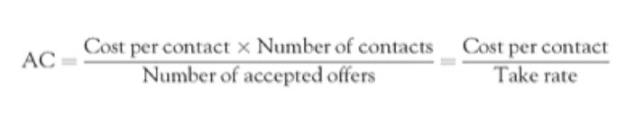
4
The Essential Operational Effectiveness Metric
Take Rate = # of accepted offers / # of contacts
AC = Acquisition Cost
David@PiedmontAve.com
©2020 Piedmont Avenue Consulting- all rights reserved
www.PiedmontAve.com

Slide 27

5
The Essential Customer Value Metric
CLTV = future value of a customer
David@PiedmontAve.com
©2020 Piedmont Avenue Consulting- all rights reserved
www.PiedmontAve.com

Slide 28

6
4 Essential Financial Metrics
Profit = revenue – cost
NPV = net present value
IRR = internal rate of return
Payback = the time for a marketing investment to pay back the cost of the initiative
David@PiedmontAve.com
©2020 Piedmont Avenue Consulting- all rights reserved
www.PiedmontAve.com

Slide 29
SCORECARD: Marketing Campaign Planning
Measurement Hierarchy
Metrics that are leading measures
Examples: brand awareness, CSAT, CLTV, test-drive
STRATEGIC
Forward-Looking Metrics
Metrics that measure specific campaign and tactic effectiveness
Examples: sales, lead conversion
TACTICAL
Backward-Looking Metrics
Metrics that measure the execution efficiency
Examples: take rate, ad dollars spent, cost to serve
OPERATIONAL
Internal-Looking Metrics
David@PiedmontAve.com
©2020 Piedmont Avenue Consulting- all rights reserved
www.PiedmontAve.com

Slide 30

SCORECARD: Marketing Campaign Planning
Strategic = forward looking metrics
i.e. evaluating brand awareness
David@PiedmontAve.com
©2020 Piedmont Avenue Consulting- all rights reserved
www.PiedmontAve.com

Slide 31
SCORECARD: Marketing Campaign Planning
Tactical = Backward looking metrics
i.e. # of sales made
David@PiedmontAve.com
©2020 Piedmont Avenue Consulting- all rights reserved
www.PiedmontAve.com

Slide 32
SCORECARD: Marketing Campaign Planning
Operational = internal metrics
i.e. evaluating the success of marketing campaigns
David@PiedmontAve.com
©2020 Piedmont Avenue Consulting- all rights reserved
www.PiedmontAve.com

Slide 33
04
Evaluate and Adjust KPI for results
David@PiedmontAve.com
©2020 Piedmont Avenue Consulting- all rights reserved
www.PiedmontAve.com

Slide 34
80 / 20 RULE
20%
80%
What is 20% of the data -
That will give 80% of the value?
David@PiedmontAve.com
©2020 Piedmont Avenue Consulting- all rights reserved
www.PiedmontAve.com

Slide 35

What are the 4 Pillars of Online Reputation Management?
Take your marketing to the next level
15 Data-Driven marketing metrics
Increase customer retention, brand awareness, customer lifetime value
Evaluate and adjust marketing KPI for results
David@PiedmontAve.com
©2020 Piedmont Avenue Consulting- all rights reserved
www.PiedmontAve.com

Slide 36

Points Covered:
Take Your Marketing to the Next Level
15 Data-Driven Marketing Metrics
Increase Customer Retention, Brand Awareness, Customer Lifetime Value & More
Evaluate and Adjust KPI for Results
David@PiedmontAve.com
©2020 Piedmont Avenue Consulting- all rights reserved
www.PiedmontAve.com

Slide 37
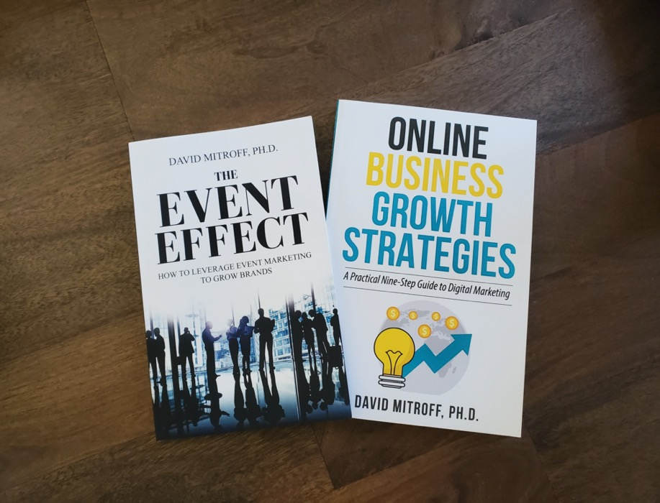

Schedule Free Consultation
510-761-5895
David@PiedmontAve.com
www.PiedmontAve.com
Learn more at www.PiedmontAve.com
David@PiedmontAve.com
©2020 Piedmont Avenue Consulting- all rights reserved
www.PiedmontAve.com

